Slide 1



Digital Design Primer
FPGA/Verilog from Scratch
DAY 2

Slide 2
Outline
Combinational Circuits
Design Procedure
Adder , Subtractor , CRA
Comparator, Decoder , Encoder
FPGA

Slide 3
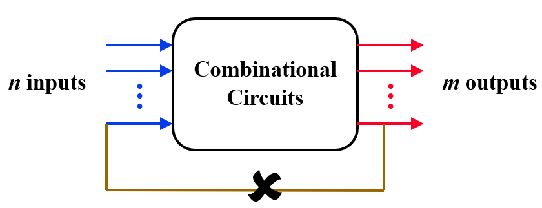
COMBINATIONAL CIRCUITS
Consist of logic gates with outputs that are determined entirely by the present value of the inputs.
When input changes, output may change (after a delay).

Slide 4
COMBINATIONAL CIRCUITS
Two important procedure
Analysis: given circuit, find out its function
Function may be expressed as:
Boolean function
Truth table
Design : given the specifications, desired function, determine circuit.
Function may be expressed as:
Boolean function
Truth table
?
?
?

Slide 5
Desıgn procedure
Given a problem statement
Determine the number of inputs and outputs.
Derive truth table.
Simplify the Boolean expression for each output.
Produce the required circuit, draw the logic diagram.

Slide 6
Binary adder
Half Adder
Adds 1-bit plus 1-bit
Produces Sum and Carry
x
y
S
C
HA
x
+ y
───
C S
x y | C S
0 0 | 0 0
0 1 | 0 1
1 0 | 0 1
1 1 | 1 0
x
y
S
C

Slide 7
Binary adder
Full Adder
Adds 1-bit plus 1-bit plus 1-bit
Produces Sum and Carry
x
y
z
FA
S
C
x
+ y
+ z
───
C S
x y z | C S
0 0 0 | 0 0
0 0 1 | 0 1
0 1 0 | 0 1
0 1 1 | 1 0
1 0 0 | 0 1
1 0 1 | 1 0
1 1 0 | 1 0
1 1 1 | 1 1
 |  |  |  | y
 |  | 0 | 1 | 0 | 1
x |  | 1 | 0 | 1 | 0
 |  |  | z
S = xy'z'+x'yz'+x'y'z+xyz = x ⊕ y ⊕ z
 |  |  |  | y
 |  | 0 | 0 | 1 | 0
x |  | 0 | 1 | 1 | 1
 |  |  | z

Slide 8
Binary adder
Full Adder
S = xy'z'+x'yz'+x'y'z+xyz = x ⊕ y ⊕ z
C = xy + xz + yz
x
y
z
c
S
C
S
C
x
y
z

Slide 9
Binary adder
Full Adder
HA
HA
x
y
z
S
C
x
y
z
S
C

Slide 10
Binary adder – 4bit
x₃x₂x₁x₀ y₃y₂y₁y₀
c₃ c₂ c₁ .
+ x₃ x₂ x₁ x₀
+ y₃ y₂ y₁ y₀
────────
Cy S₃ S₂ S₁ S₀
Binary Adder
Carry Propagate Addition
C_{y}
C₀
S₃S₂S₁S₀
x₃ x₂ x₁ x₀
y₃ y₂ y₁ y₀
0
FA
FA
FA
FA
C₄ C₃ C₂ C₁
S₃ S₂ S₁ S₀

Slide 11
Binary subtractor
Use 2’s complement with binary adder
x – y = x + (-y) = x + y’ + 1

Slide 12
comparator
Compare 2-bit number to 2-bit number
3 Outputs: < , = , >
Expandable to more number of bits like 4-bit
A₁A₀ B₁B₀
Magnitude Comparator
A<B A=B A>B

Slide 13

decoder
2-to-4 Line Decoder
Binary Decoder
y₃
y₂
y₁
y₀
I₁
I₀
I₁ I₀ | Y₃ Y₂ Y₁ Y₀
0 0 | 0 0 0 1
0 1 | 0 0 1 0
1 0 | 0 1 0 0
1 1 | 1 0 0 0

Slide 14
multiplexers
S₁ S₀ | Y
0 0 | I₀
0 1 | I₁
1 0 | I₂
1 1 | I₃
MUX
I₀
I₁
I₂
I₃
Y
S₁ S₀

Slide 15
multiplexers
2-to-1 MUX
4-to-1 MUX
MUX
I₀
I₁
Y
S
MUX
I₀
I₁
I₂
I₃
Y
S₁ S₀

Slide 16
Implementation Using Multiplexers
Example F (x, y) = ∑(0, 1, 3)
x y | F
0 0 | 1
0 1 | 1
1 0 | 0
1 1 | 1
MUX
1
1
0
1
I₀
I₁
I₂
I₃
Y
F
S₁ S₀
x y

Slide 17
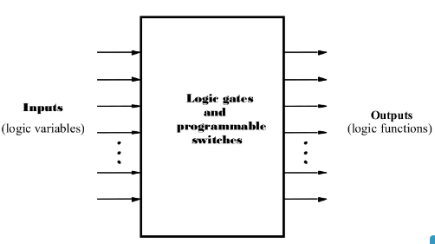
FPGA
FPGA is a programmable logic device (PLD). PLD is a general purpose chip for implementing circuits and can be customized using programmable switches
Main types of PLDs
PLA
PAL
ROM
FPGA

Slide 18
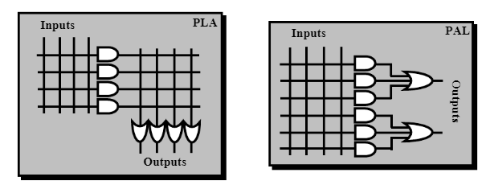
Programmable logic array (pla)
Use to implement circuits in SOP form
The connections in the AND & OR plane are programmable

Slide 19
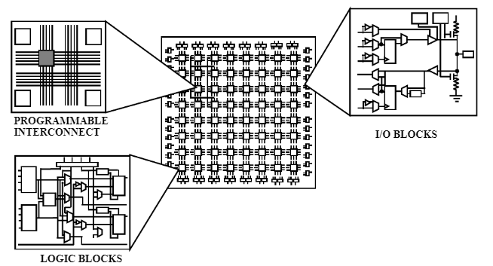
FPGA
Definition of field programmable gate array (FPGA): contains a matrix of reconfigurable gate array logic circuitry.
Why do we need FPGA?
Alternative to custom IC
Implemented in a short time
using CAD tools

Slide 20
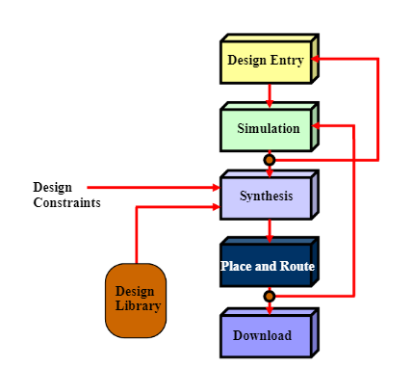
FPGA
Programmable logic design process

Slide 21
Digital Design Primer
FPGA/Verilog from Scratch
DAY 2 - lab

Slide 22
Outline
Dataflow Verilog
Lab exercises
Modelsim Test

Slide 23
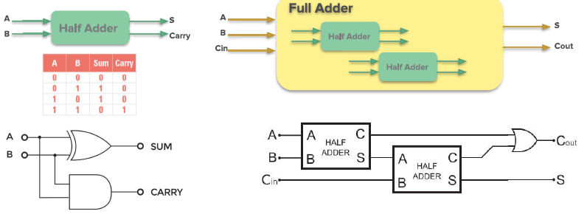
Full Adder

Slide 24
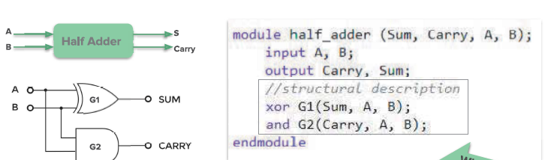
Full Adder

Slide 25
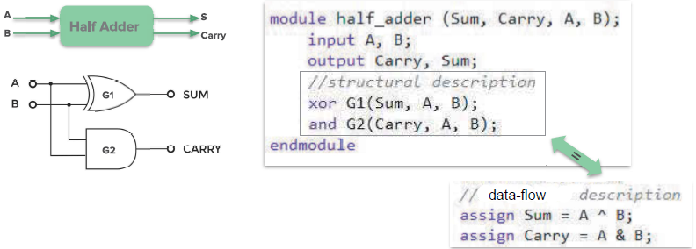
Full Adder

Slide 26
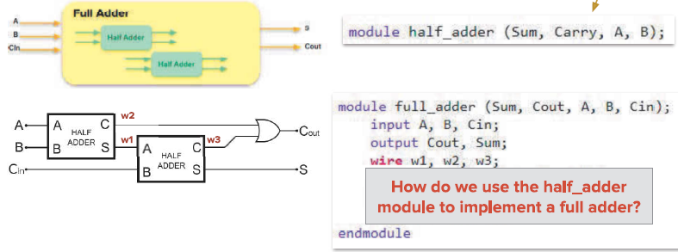
Full Adder

Slide 27
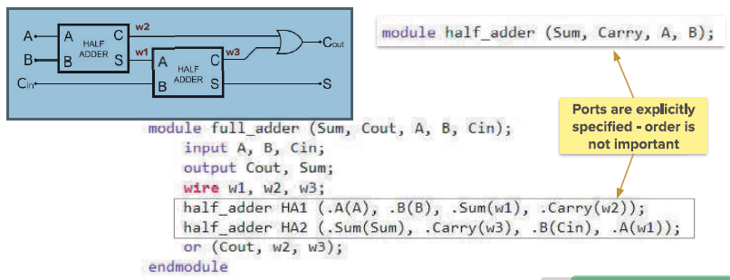
Full Adder

Slide 28
Adder/subtractor
Add new module: subtractor 4-bit.
Add overflow bit.
Running the design on the FPGA board.

Slide 29
Comparing two numbers
Compare 4-bit number to 4-bit number
1 output: =
Part1:
Draw truth table & write logic equation
Simplify the equation with K-map
Part2:
Implement the design with structural Verilog
Running the structural design on the simulator.
Implement the design with data flow Verilog
Running the data flow design on the FPGA board.

Slide 30
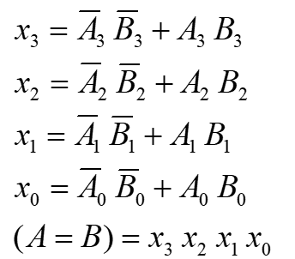
Comparing two numbers
Compare 4-bit number to 4-bit number
1 ouput =
A₃A₂A₁A₀ B₃B₂B₁B₀
Magnitude Comparator
A<B A=B A>B

Slide 31
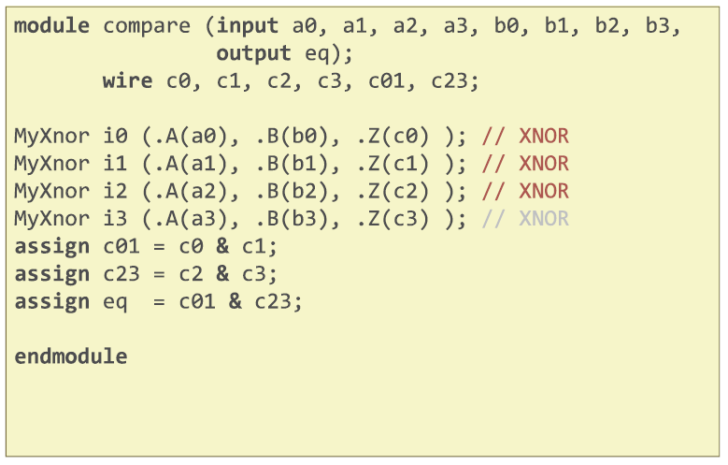
Comparing two numbers

Slide 32
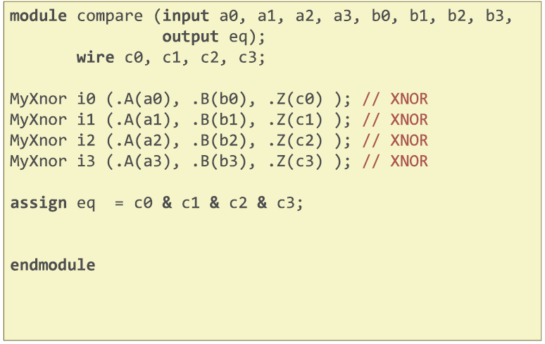
Comparing two numbers

Slide 33
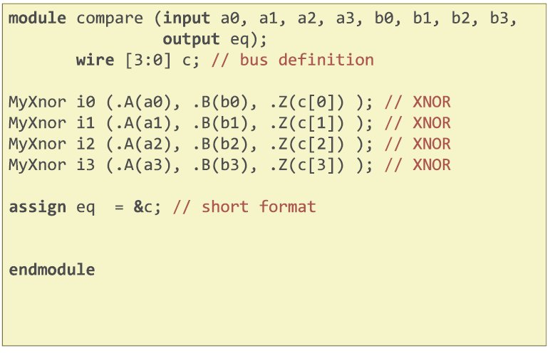
Comparing two numbers

Slide 34
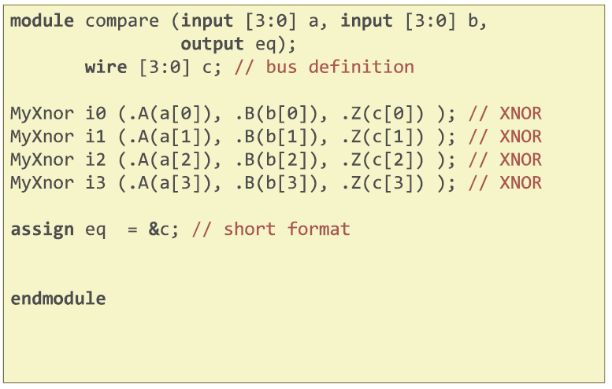
Comparing two numbers

Slide 35
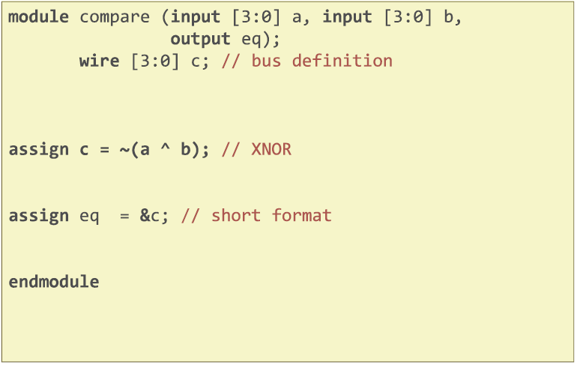
Comparing two numbers

Slide 36
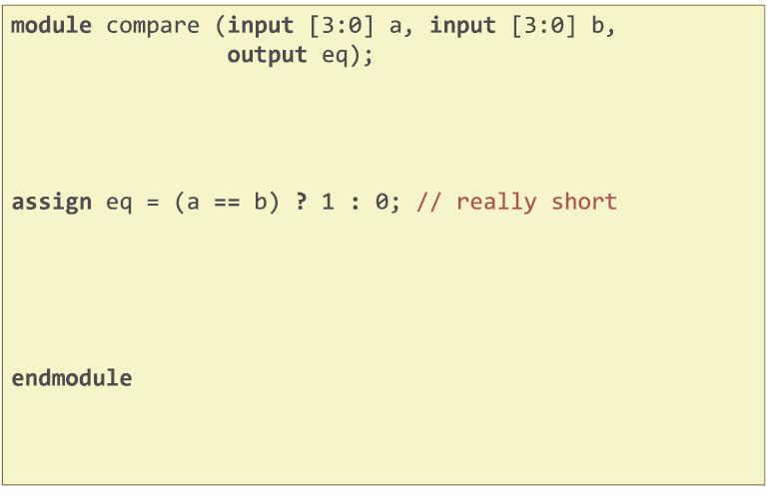
Comparing two numbers

Slide 37
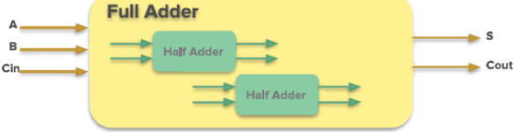
Write testbench
Logic blocks (filename.v)
Wil be synthesized
no # delaysexcept for registers
Testing blocks (filename_testbench.v)
Pretty much anything goes
Need # delay statements
Instantiate logic blocks inside testing blocks and drive the inputs and check outputs there
fullAdder_testbench.v
fullAdder.v

Slide 38
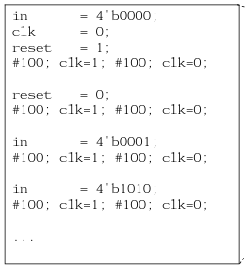
Write testbench
Basic flow example for testbench
fullAdder_testbench.v
fullAdder.v

Slide 39
Write testbench
A number of ways to verify designs
Eyeball text printouts
Quick and easiest
Eyeball waveforms
Quick and easy
Write reference code and some other code to see if the two are the same. Make sure you temporarily force an error to test your setup.
This is the most robust and what ius required for non-trivial designs.

Slide 40
Write testbench
for 4-bit Full Adder write testbench and run on modelsim.

Slide 41
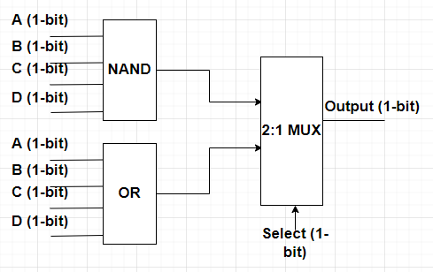
Combinational design
Implement the design with structural or dataflow Verilog
You have to write these modules:
Your main module
_4nnand
_4or
_2to1_mux
Running the design on the FPGA board.

